Slide 1
Risk Analysis of UPS
Nicholas Coombes, Charles Kindt, Logan Clay, Constance McConnon, Jordan Fisher, Michele Calderon

Slide 2
Overview of UPS
Organization: UPS (United Parcel Service)
Sector/industry: Transportation
Locations: Over 220 countries globally
Employees: Approximately 528,000 globally

Slide 3

Background Information
Global leader in package shipping and delivery
In 2019, delivered 5.5 Billion packages and documents globally
Comprised of various organization heads from well-known companies
AT&T, Heinz, CVS

Slide 4
Mission of UPS
The mission of UPS is to distribute packages to businesses and consumers in a safe and timely manner while efficiently applying solutions that are convenient for their customer base. They focus not only on the convenience of the customers, but also the convenience and efficiency of their operations by focusing on data analytics and market insights as well as being innovative within the areas of supply chain management, logistics, and business solutions.

Slide 5
Essential Business Functions
Operation of information systems for supply chain management and logistics
Pickup and delivery of parcels and documents with signatures when required
Maintenance of fleet delivery vehicles
Reach high customer satisfaction by making sure packages arrive when expected
Warehouse operations (heavy machines, packaging)
Research and development of new technologies for shipping and receiving

Slide 6
Stakeholder Analysis
Major Stakeholders | Urgency | Legitimacy | Capacity | Importance
Definitive- CEO, Board Members | X | X | X | 4
Dominant- Governments (Domestic and International) |  | X | X | 2
Dangerous – Disgruntled employees, Hackers, Robbers | X |  | X | 3
Dependent- Customers | X | X |  | 3

Slide 7
Stakeholder Analysis (cont.)
Understanding the stakeholders and their level of importance, we can see who will be affected most by security risks and incidents
Allows us to better assess which risks will have the greatest impact on the business functions of UPS
For example, mitigation of loss of tracking information will improve business performance and customer satisfaction

Slide 8
Project Scope Statement
For this project, we will be focusing on the business aspects of information security, shipping and delivery, and fleet maintenance. The reasoning behind this is that we are focusing on the importance and efficiency of UPS's ability to deliver packages safely and efficiently to their respective customers. Without these three business functions, UPS main form of economic stability would faulter and potentially lead them to go under.

Slide 9
Assets
Information Security
Data | Customer records, Shipment information
Software | Databases, tracking systems
Hardware | Computers/Laptops/Tablets, Servers, Routers
Employees | Information Security Personnel
Machinery | See hardware above
Facilities | Data centers, Warehouses, Retail stores

Slide 10
Assets (cont.)
Shipping and Delivery
Data | Customer records, Shipment information
Software | Databases, tracking systems
Hardware | Printers, Scanners, Satellites
Employees | Warehouse, Delivery Drivers
Machinery | Forklifts, Delivery Vehicles
Facilities | Warehouses

Slide 11
Assets (cont.)
Fleet Maintenance
Data | Service Records
Software | Maintenance Software, Diagnostic Tools
Hardware | Tools, Vehicle Parts
Employees | Mechanics, Service Writers
Machinery | Equipment (e.g. Vehicle Lifts)
Facilities | Warehouses, Repair Facilities

Slide 12
Potential Security Incidents/Accidents
Information Security
Security Incident/Accident | Category | Covered in Analysis?
Data Breach | 2 | Yes
Power Outage | 2 | No
Hardware Failure | 2 | No

Slide 13
Potential Security Incidents/Accidents (cont.)
Shipping and Delivery
Security Incident/Accident | Category | Covered in Analysis?
Delivery Vehicle Accident | 1 | Yes
Logistics System Failure | 2 | No
Package(s) Lost, Stolen, or Damaged | 1 | Yes
Warehouse Fire | 2 | No

Slide 14
Potential Security Incidents/Accidents (cont.)
Fleet Maintenance
Security Incident/Accident | Category | Covered in Analysis?
Vehicle Damaged During Repair | 1 | No
Incorrect Service Records | 2 | Yes
Natural Disaster | 3 | No

Slide 15

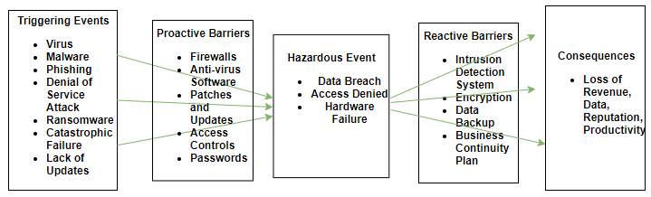

Bow-Tie Model: Information Security
Hazards: Human Error, Electrical Issues, Cyber Threats, Hardware & Software Controls

Slide 16
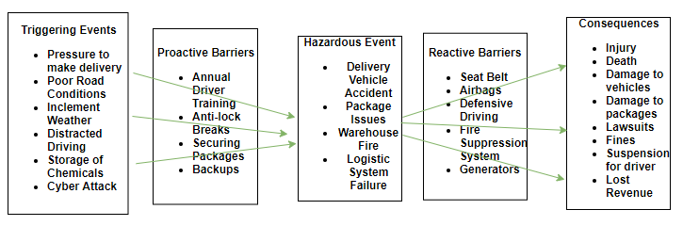
Bow-tie Model: Shipping & Delivery
Hazards: Poor Safety Culture, Stress, Storms, Explosions, Theft, Cyber Threat

Slide 17
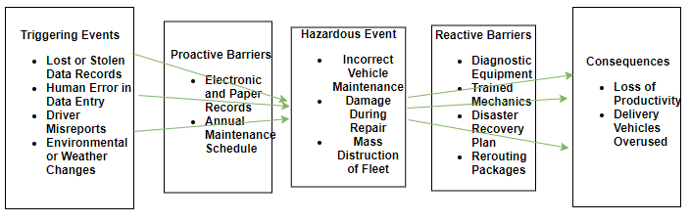
Bowtie-model: Fleet Maintenance
Hazards: Poor Maintenance, Poor Safety Culture, Human Error, Natural Disasters, Storms

Slide 18
Risk Influencing factors
Information Security
Operational RIF | Operational Procedures, Controls, Routine Maintenance
Organizational RIF | Cyber Security Culture
Regulatory/Customer RIF | Protection of Customer Information, Proprietary Info
Shipping & Delivery
Operational RIF | Operational Procedures, Controls, Routine Maintenance
Organizational RIF | Cyber Security Culture
Regulatory/Customer RIF | Protection of Customer Information, Proprietary Info

Slide 19
Risk Influencing Factors (cont.)
Fleet Maintenance
Operational RIF | Automatic Scheduling, Reporting Vehicle Issues
Organizational RIF | Health & Safety Culture, Teamsters Union
Regulatory/Customer RIF | Federal Motor Carrier Safety Administration, OSHA, Customer Satisfaction

Slide 20
Accident Scenario
Delivery Vehicle Accident
Driver following too closely to vehicle ahead (Initiating Event)
Vehicle ahead stops suddenly
Anti-lock brakes fail
Driver rear-ends vehicle ahead
Airbags fail to deploy on impact
Damage to packages that are not secured
Driver suffers injuries, driver in vehicle ahead suffers injuries
Lawsuit occurs from delivery driver liability

Slide 21
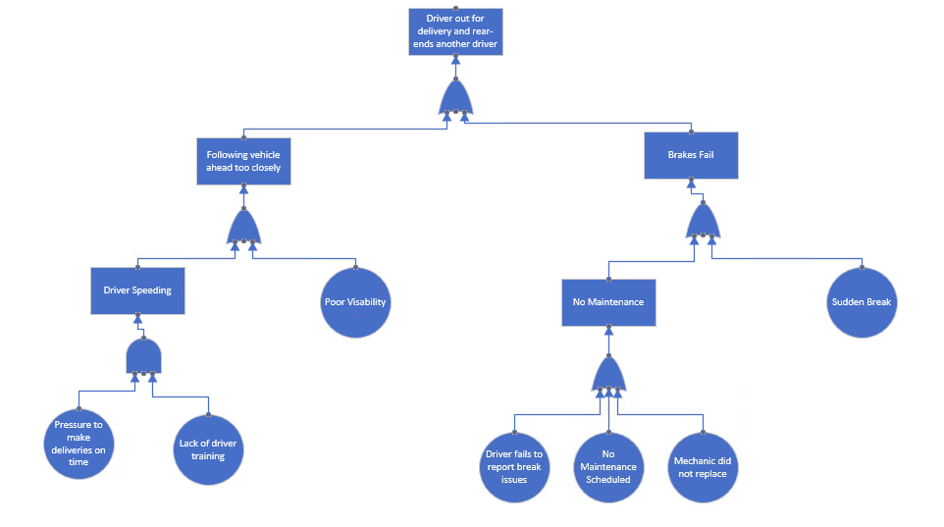
Causal and Frequency Analysis
A fault tree analysis can help to determine what causes the top event or accident to occur.

Slide 22
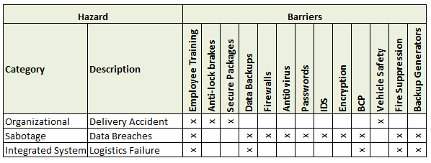
Barrier Analysis
The barrier analysis shows the barriers that exist and are relevant to the specific hazard.
It also indicates what barriers protect against multiple hazards.

Slide 23
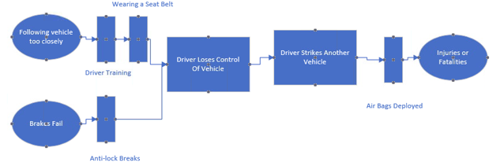
Safety Barrier Diagram
Barriers can be proactive or reactive.
Can also show where there are potential gaps.

Slide 24
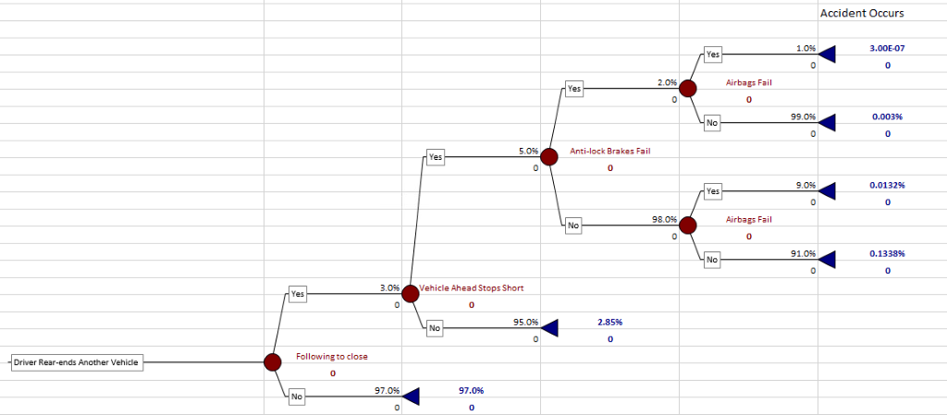
Event Tree: Before Control
Incorporates both Shipping & Delivery and Fleet Maintenance business functions.

Slide 25
Personal safety issues
IPRA
Exposure Time Rate = 41.9 / 168 (hours in a week) = .249 or 24.9%
IRPA = 607 / 51410 * .249 = .0029
PLL
PLL = 7870 * .0029 = 23.14 fatalities
Data:
UPS- 7,077 vehicles, 7,870 drivers
U.S. Bureau of Labor Statistics- Light and deliver service truck drivers
Population- 51,410 (2019)
Average weekly hours- 41.9 (2020)
Number of fatalities- 607 (2019)

Slide 26
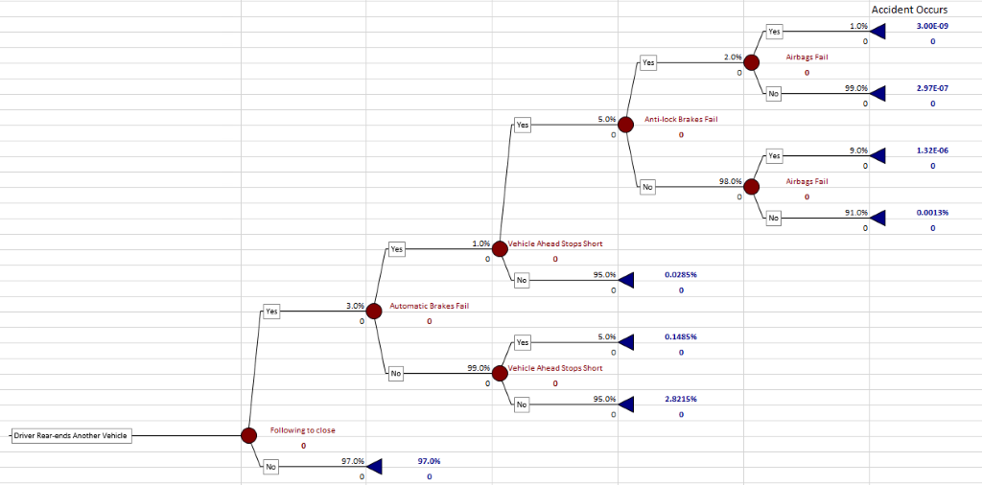
Event tree: After Control
Through our analysis we concluded that the most efficient control to use is an automatic braking system to avoid collision if following too close

Slide 27
References
Board of Directors. (n.d.) UPS Investors.
Retrieved fromhttp://www.investors.ups.com/governance/board-of-directors
Federal Motor Carrier Safety Administration. (2020). UPS Ground Freight INC.
Retrieved from https://ai.fmcsa.dot.gov/SMS/Carrier/121058/BASIC/UnsafeDriving.aspx
National Institute of Standards and Technology/U.S. Department of Commerce. (2012).
NIST Special Pubilication 800-30: Guide for Conducting Risk Assessments Revision 1 [PDF].
Gaithersburg, MD. Retrieved from https://nvlpubs.nist.gov/nistpubs/Legacy/SP/nistspecialpublication800-30r1.pdf
Rausand, M. & Safari Books Online (Firm). (2011). Risk assessment: Theory, methods, and applications (1st ed). Wiley.
Retrieved from https://learning.oreilly.com/library/view/risk-assessment-theory/9780470637647/13_chapter04.html
UPS Fact Sheet. (n.d.). UPS Pressroom. Retrieved from https://pressroom.ups.com/pressroom/ContentDetailsViewer.page?ConceptType=FactSheets&id=1426321563187-193
U.S. Bureau of Labor Statistics. (2020). Industries at a Glance: Truck Transportation NAICS 484. Retrieved from https://www.bls.gov/iag/tgs/iag484.htm
U.S. Bureau of Labor Statistics. (2020). Injuries, Illnesses, Fatatlies: Fact Sheet Truck Drivers 2018, July 2020. Retrieved from https://www.bls.gov/iif/oshwc/cfoi/truck-drivers-2018.htm#_edn5

